Slide 1
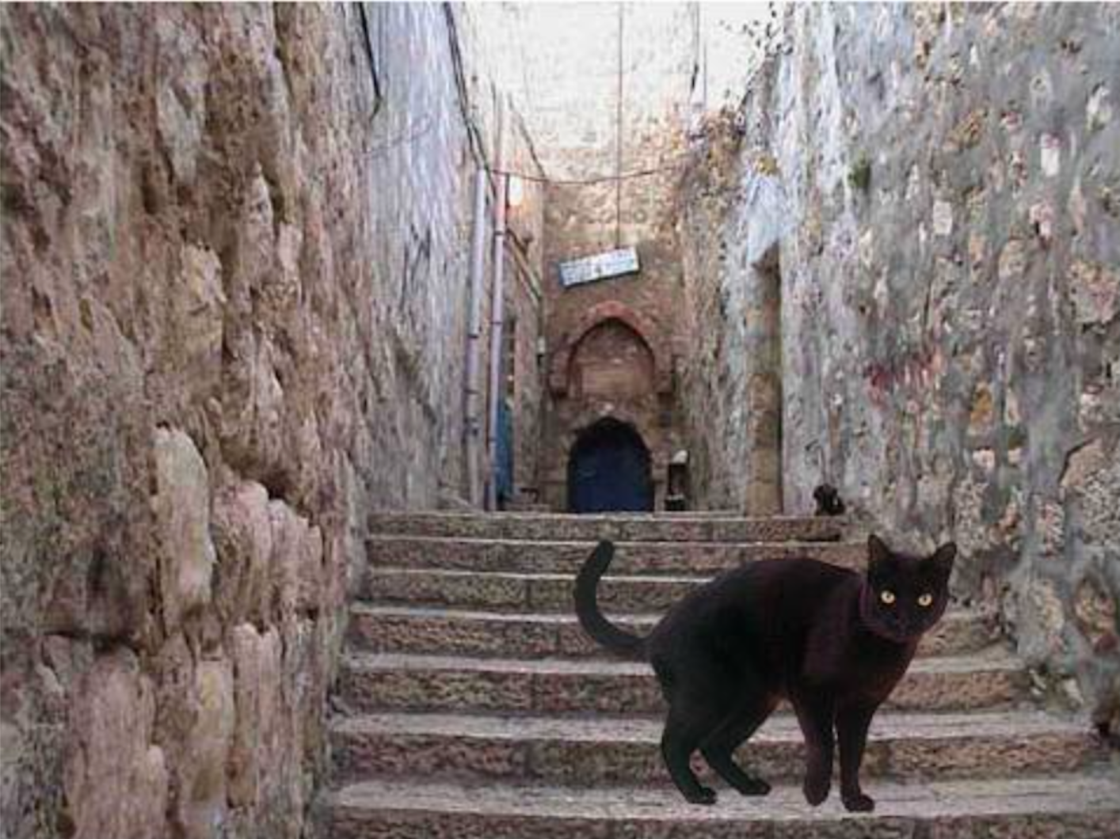

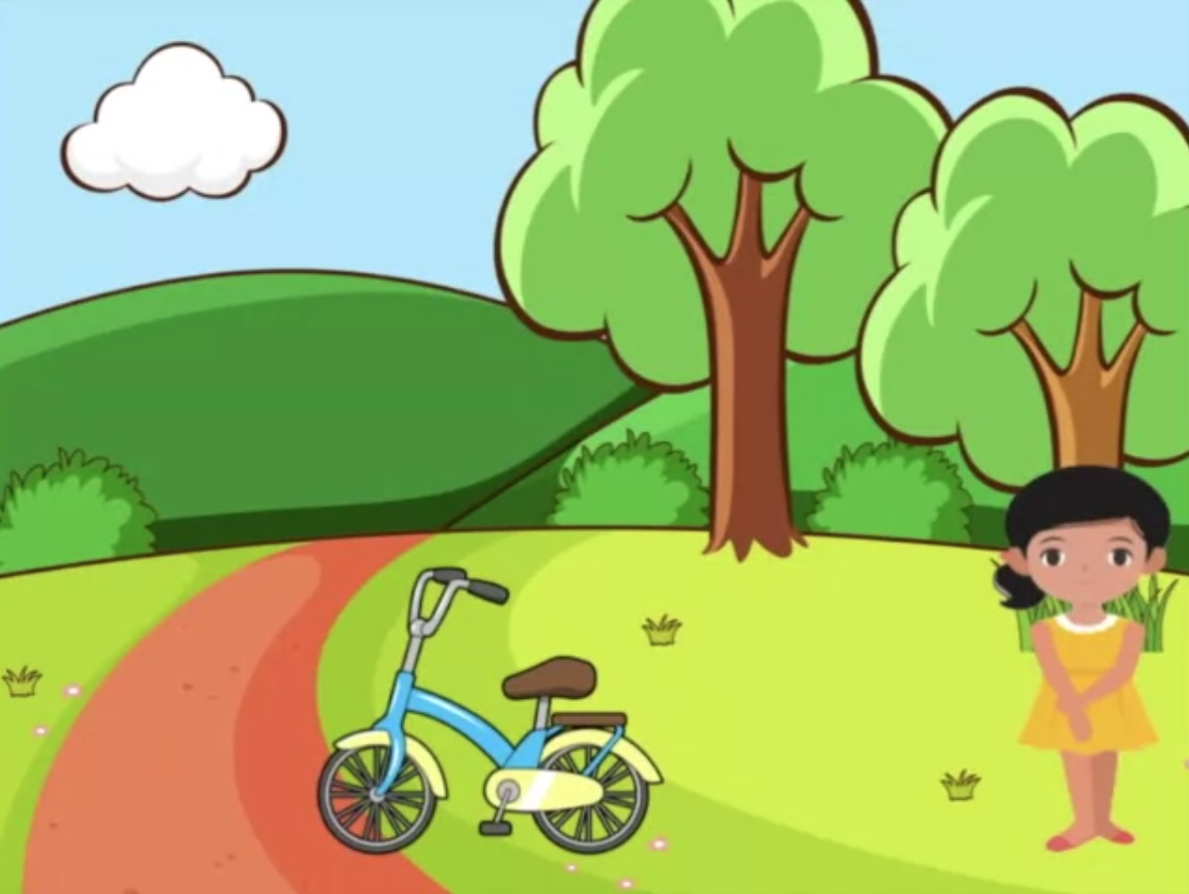

1
Relational Preference
2
Free Description
Pick the tray that has the things that will make my toy play music.
请选择装着能让我的玩具播音乐的东西的托盘。
What did you see?
你看到了什么？
3
Causal Attribution
4
Uniqueness Preference
Why didn’t Lucy play on the bicycle? Is it because she is the kind of person who gets scared, or because the bicycle is dangerous to play on?
璐茜为什么不骑自行车？是因为她是那种会怕怕的人，还是因为这辆自行车骑起来很危险？
You can only pick one sticker. Which one do you want to pick?
你只能选一个小贴纸。你想选哪一个呢？

